Slide 1
Data Driven Decision Making
Sessie 1 Witek ten Hove

Slide 2
Data Driven Decision Making
Belang van data verzamelen. Scheepslogboeken >> Klimaatverandering

Slide 3
Klimaatverandering

Slide 4
Data Driven Business

Slide 5
Slide with R Output
summary(cars)
## speed dist ## Min. : 4.0 Min. : 2.00 ## 1st Qu.:12.0 1st Qu.: 26.00 ## Median :15.0 Median : 36.00 ## Mean :15.4 Mean : 42.98 ## 3rd Qu.:19.0 3rd Qu.: 56.00 ## Max. :25.0 Max. :120.00

Slide 6
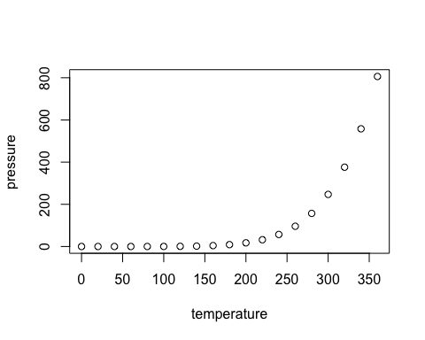
Slide with Plot

